Slide 1
Statistics and Reliability: Module 8
Regression
Notes:
Module Topics
Simple linear regression
Relationships between variables X and Y
Prediction: If X = x, then Y = ?
Multiple linear regression
Relationships between variables X₁, X₂, X₃,... and Y
Prediction: If X₁ = x₁, X₂ = x₂, X₃ = x₃,..., then Y = ?
Copyright (c) Deere & Company, as an unpublished work. This material is the property of Deere & Company. All use, disclosure, and/or reproduction not specifically authorized by Deere & Company is prohibited.

Slide 2
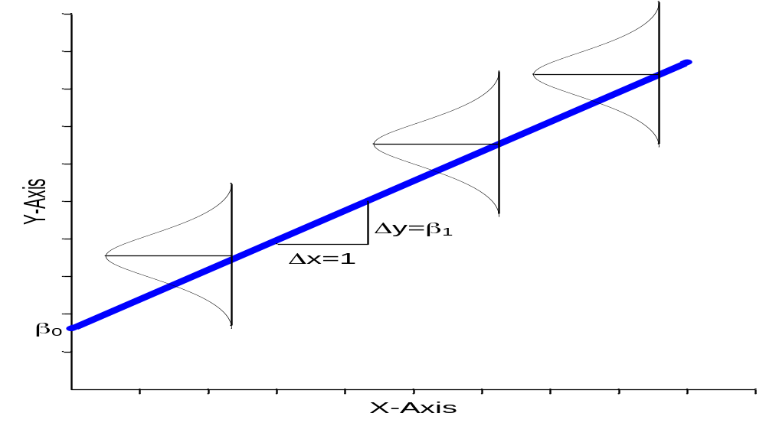
Regression Assumptions
Notes:
Y = β₀ + β₁·X + ε
β₀ = intercept
β₁ = slope
ε = error (or residual)
ε distribution
normal
E(ε) = 0
SD(ε) = σ
In English, ε has a normal distribution - N(0, σ²) - with values that are Independent and Identically Distributed (IID).
[acknowledgement to Dr. Don N. Kleinmuntz, University of Illinois College of Business]

Slide 3

Regression Estimates
Notes:
Y = b₀ + b₁·X + e
b₀ = intercept
b₁ = slope
e = error (or residual)
find b₀ & b₁ to minimize residual sum of squares
Y distribution
normal
E(Y) = b₀ + b₁·X
SD(Y) = s_{e} (standard error of estimate)
[acknowledgement to Dr. Don N. Kleinmuntz, University of Illinois College of Business]

Slide 4
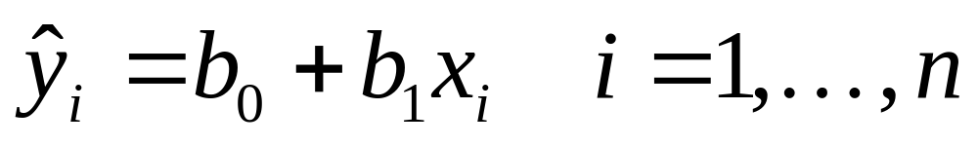
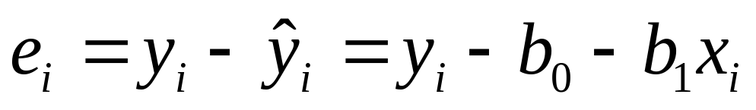
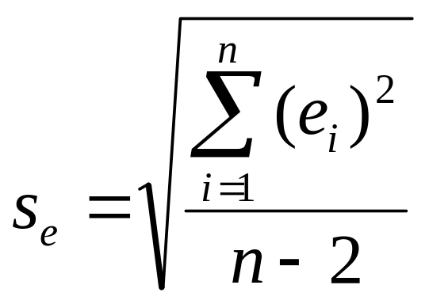
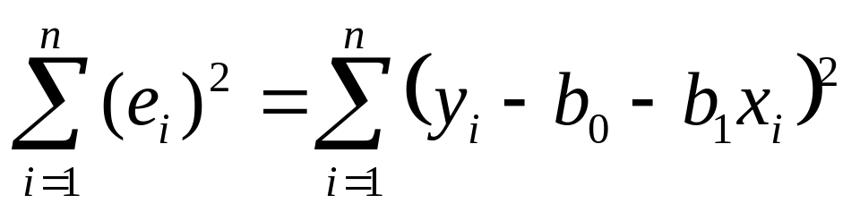
Residual Analysis
Notes:
Use data to find values b₀ and b₁ that estimate “true” parameters β₀ and β₁
Predicted Y_{i}
Residuals e_{i}
Residual sum of squares
Standard error of estimate s_{e}
[acknowledgement to Dr. Don N. Kleinmuntz, University of Illinois College of Business]

Slide 5
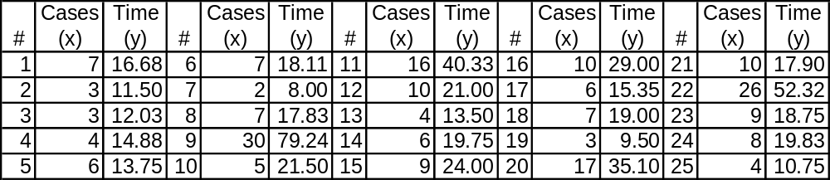
Table 23.1 Delivery Time Data
Notes:
23.4 Example 23.1 Correlation
Page 487: “The times for 25 soft drink deliveries (y) monitored as a function of delivery volume (x) is shown in Table 23.1.”

Slide 6
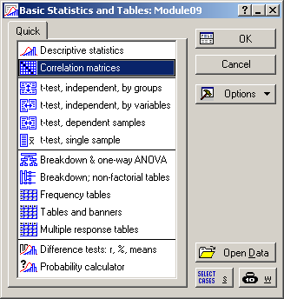
Notes:
Statistics > Basis Statistics/Tables > Correlation matrices

Slide 7
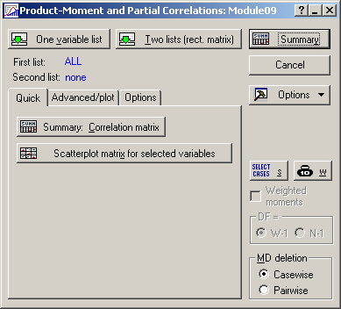
Notes:
One variable list
Cases
Time
Because there were only two variables in the data set, Statistica shows:
First list: ALL

Slide 8
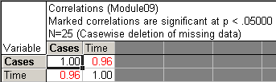
Notes:
Compare to the result on page 487.
The correlation coefficient is the same: 0.96.
The correlation is considered to be statistically significant for α = 0.05 since it is marked in red.

Slide 9
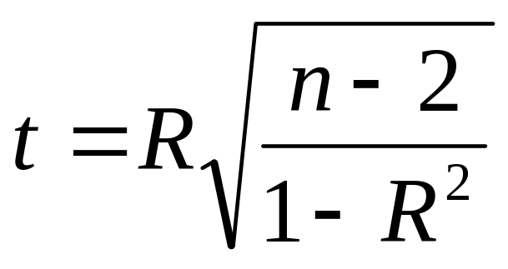
Correlation Hypothesis Testing
The P-value refers to the two-tailed correlation test of hypothesis:
The null is: H₀: ρ = 0 (i.e., no significant correlation)
The alternative is: H_{a}: ρ ≠ 0 (i.e., a significant correlation)
The test statistic depends on r
The degrees of freedom (df) = n-2 and n is the number of pairs of data
Notes:
[http://mtsu32.mtsu.edu:11308/regression/level2/correl/pvalueinterp.htm]
The significance level calculated for each correlation is a primary source of information about the reliability of the correlation. The significance of a correlation coefficient of a particular magnitude will change depending on the size of the sample from which it was computed. The test of significance is based on the assumption that the distribution of the residual values (i.e., the deviations from the regression line) for the dependent variable y follows the normal distribution, and that the variability of the residual values is the same for all values of the independent variable x. However, Monte Carlo studies suggest that meeting those assumptions closely is not absolutely crucial if your sample size is not very small and when the departure from normality is not very large. It is impossible to formulate precise recommendations based on those Monte Carlo results, but many researchers follow a rule of thumb that if your sample size is 50 or more then serious biases are unlikely, and if your sample size is over 100 then you should not be concerned at all with the normality assumptions. There are, however, much more common and serious threats to the validity of information that a correlation coefficient can provide; they are briefly discussed in the following paragraphs.

Slide 10
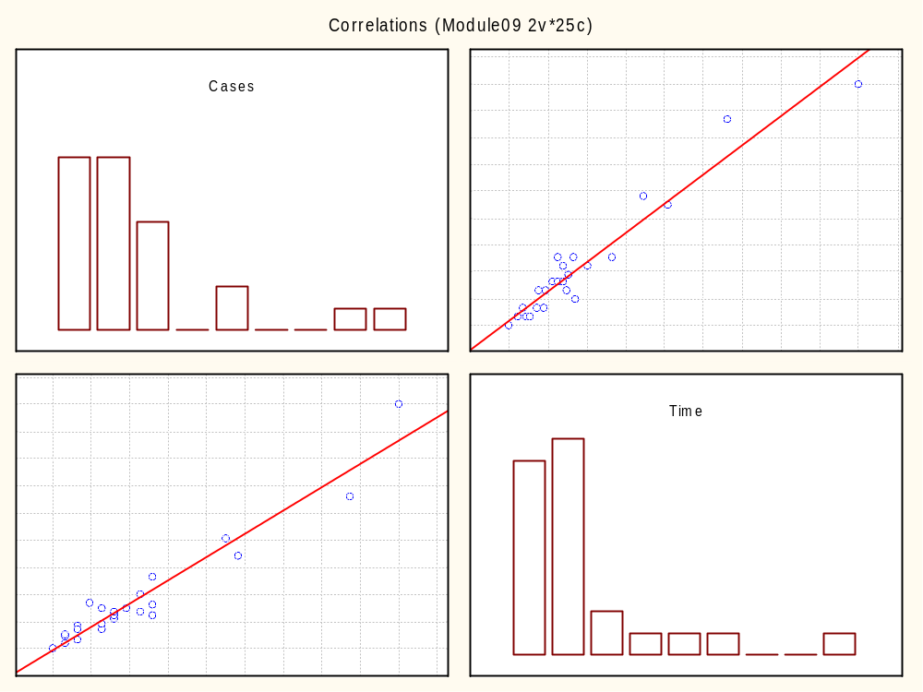
Notes:
Return to the “Product-Moment and Partial Correlations” menu, select the “Scatter plot matrix for selected variables” button, and select both Cases and Time, and click “OK”.
Compare the plot in the lower left hand corner to FIGURE 23.2 Plot of number of cases versus delivery time.

Slide 11
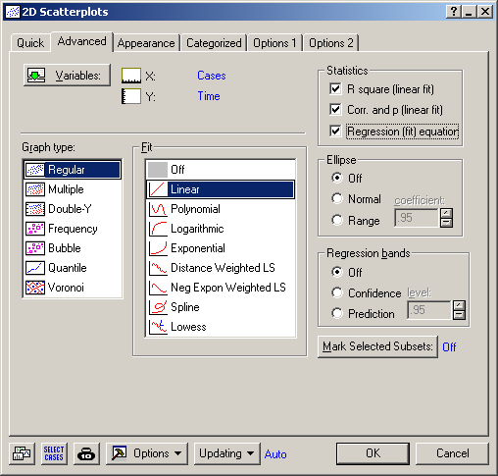
Notes:
Graphs > Scatterplots > Advanced tab
X = Cases
Y = Time
Fit = Linear
Check:
R square (linear fit)
Corr. And p (linear fit)
Regression (fit) equation

Slide 12
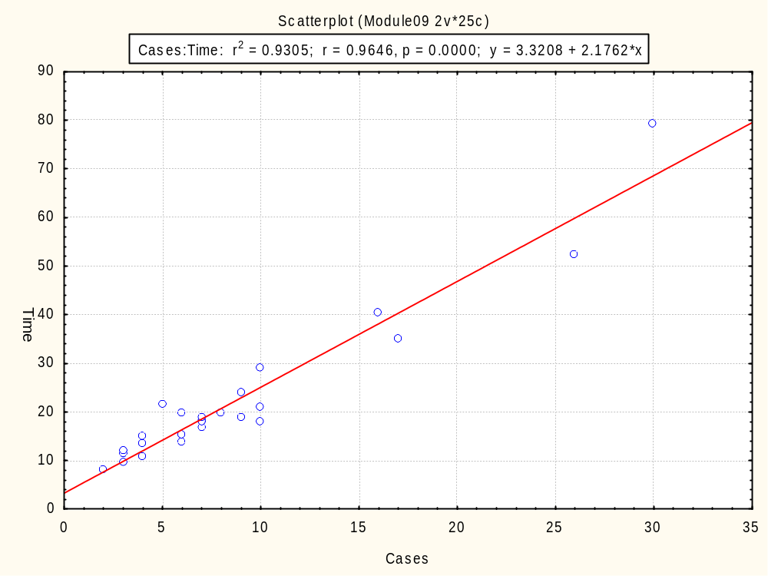
Notes:
Compare to FIGURE 23.3 Regression plot of number of cases versus delivery time. Y = 2.32 + 2.18X; R² = 93.0%; CI = confidence interval; PI = prediction interval.
The CI and PI are not shown on this version.

Slide 13
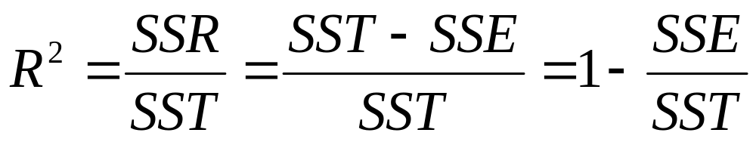
R and R²
SSR = Sum of Squares Regression
SST = Sum of Squares Total
SSE = Sum of Squares Error
Notes:
The correlation coefficient (R) represents the linear relationship between two variables. If the correlation coefficient is squared, then the resulting value (R², the coefficient of determination) will represent the proportion of common variation in the two variables (i.e., the "strength" or "magnitude" of the relationship). In order to evaluate the correlation between variables, it is important to know this "magnitude" or "strength" as well as the significance of the correlation.
SSR, SST and SSE come from ANOVA.

Slide 14
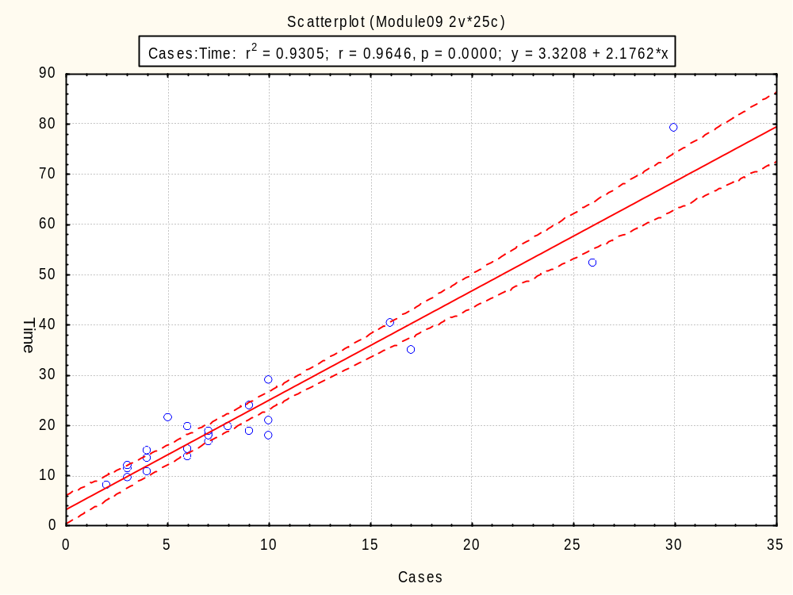
Notes:
Return to the “2D Scatterplots” menu’s Advanced tab and select “Confidence” in the “Regression bands” section (with level = 0.95).
Compare to FIGURE 23.3 Regression plot of number of cases versus delivery time. Y = 2.32 + 2.18X; R² = 93.0%; CI = confidence interval; PI = prediction interval.
Only the CI is shown on this version. The CI is for the mean of distribution about the fitted line.

Slide 15
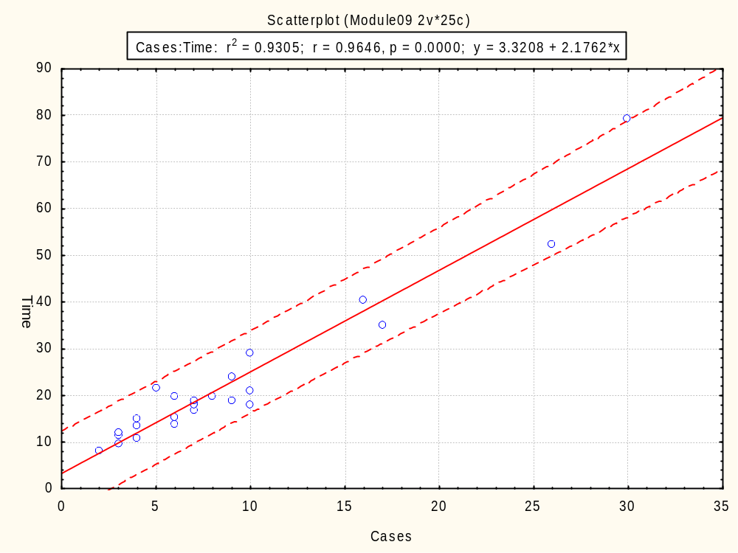
Notes:
Return to the “2D Scatterplots” menu’s Advanced tab and select “Prediction” in the “Regression bands” section (with level = 0.95).
Compare to FIGURE 23.3 Regression plot of number of cases versus delivery time. Y = 2.32 + 2.18X; R² = 93.0%; CI = confidence interval; PI = prediction interval.
Only the PI is shown on this version. The PI is for an individual value about the fitted line.

Slide 16
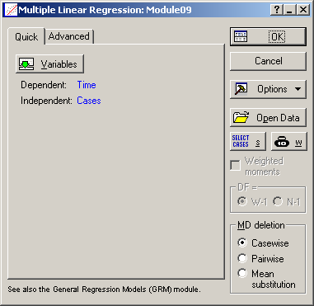
Notes:
Statistics > Multiple Regression
Dependent = Time
Independent = Cases

Slide 17
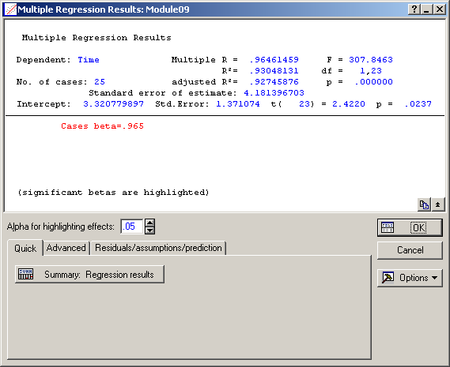
Notes:
Summary statistics are listed on top, e.g.:
Multiple R = 0.965
R² = 0.93
Intercept = 3.32 with a p-value = 0.0237
Select “Summary: Regression results”

Slide 18
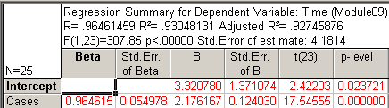
Notes:
Compare top section of the “Regression Analysis” listed on page 494.
Both the intercept of 3.32 (p-value = 0.02) and the slope of 2.18 (p-value = 0.00) are statistically significant.

Slide 19
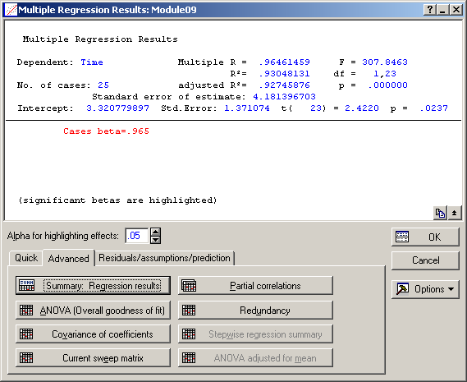
Notes:
Return to the “Multiple Regression Results” menu, go to the “Advanced” tab, and select “ANOVA (Overall goodness of fit)”.

Slide 20
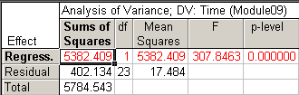
Notes:
Compare middle section of the “Regression Analysis” listed on page 494.
The regression equation is very statistically significant – there’s virtually no chance of observing these results if there was no linear relationship.

Slide 21
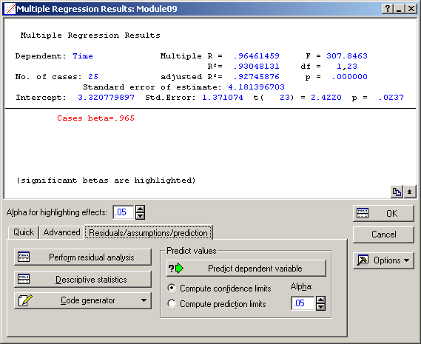
Notes:
Return to the “Multiple Regression Results” menu, go to the “Residuals/assumptions/prediction” tab, and select “Perform residual analysis”.
Then select:
“Normal plot of residuals” on the “Probability plots” tab
“Histogram of residuals” on the “Residuals” tab
“Predicted vs. residuals” on the “Scatterplots” tab
“Save residuals & predicted” on the “Save” tab
Then make an individuals (“X”) plot of the “Residuals” column using:
Statistics > Industrial Statistics & Six Sigma > Quality Control Charts

Slide 22
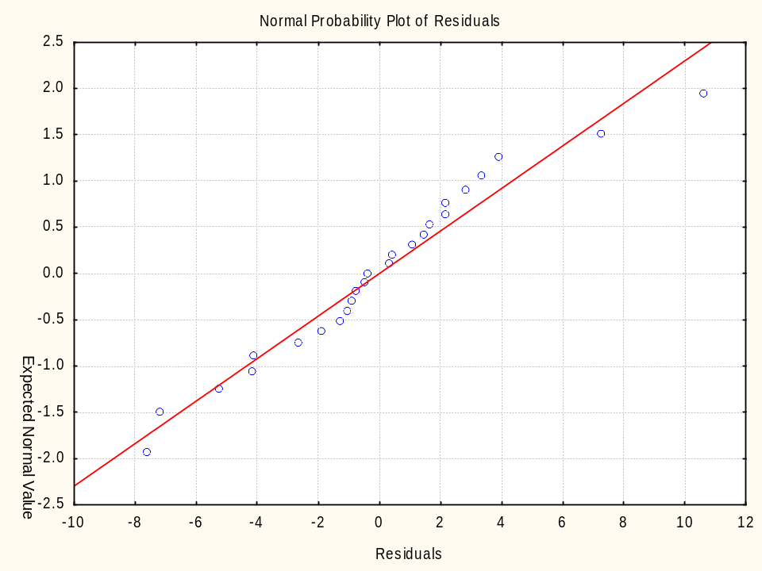
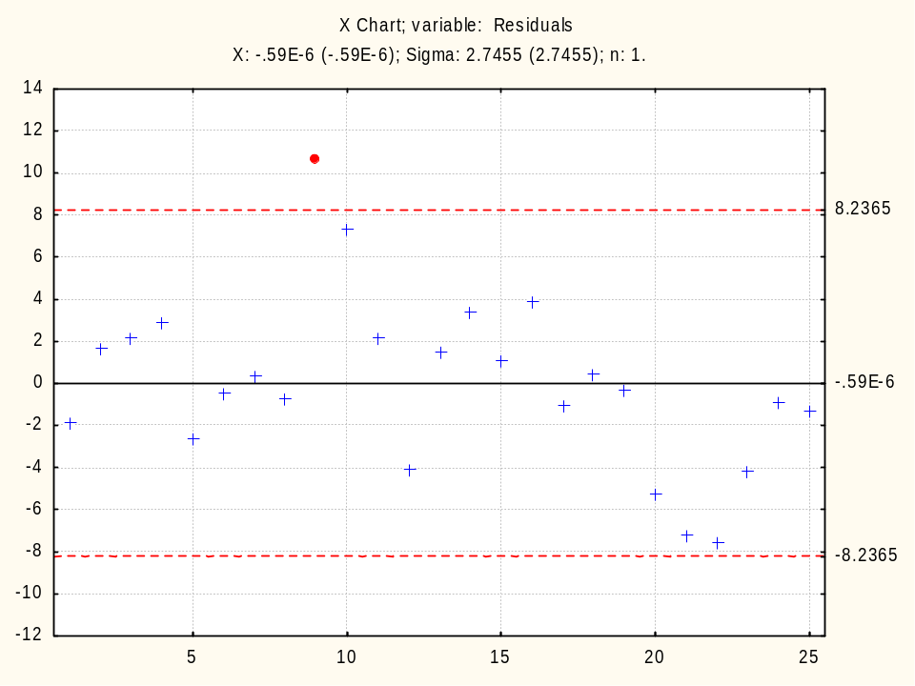
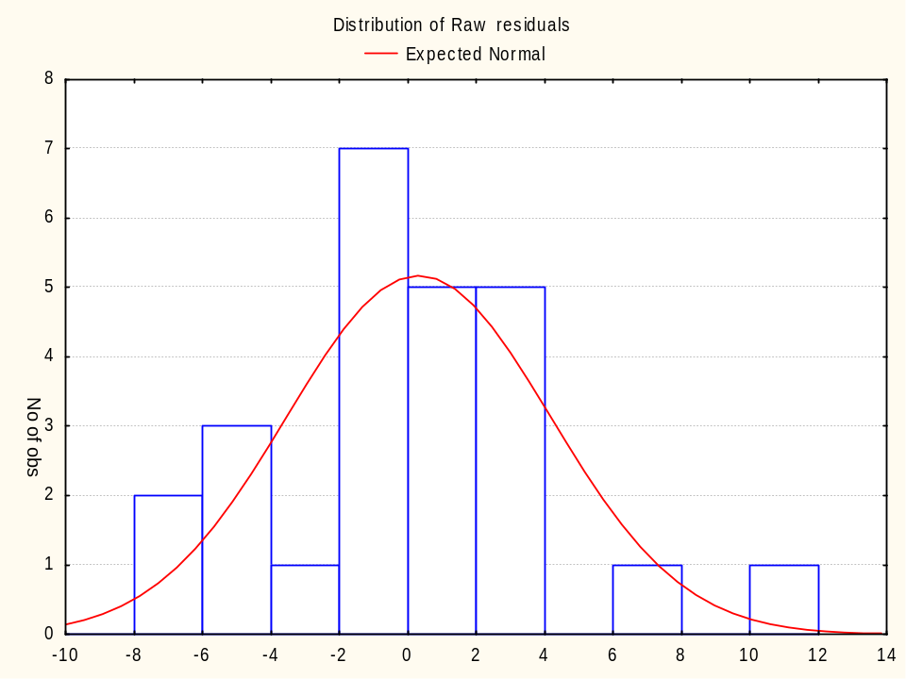
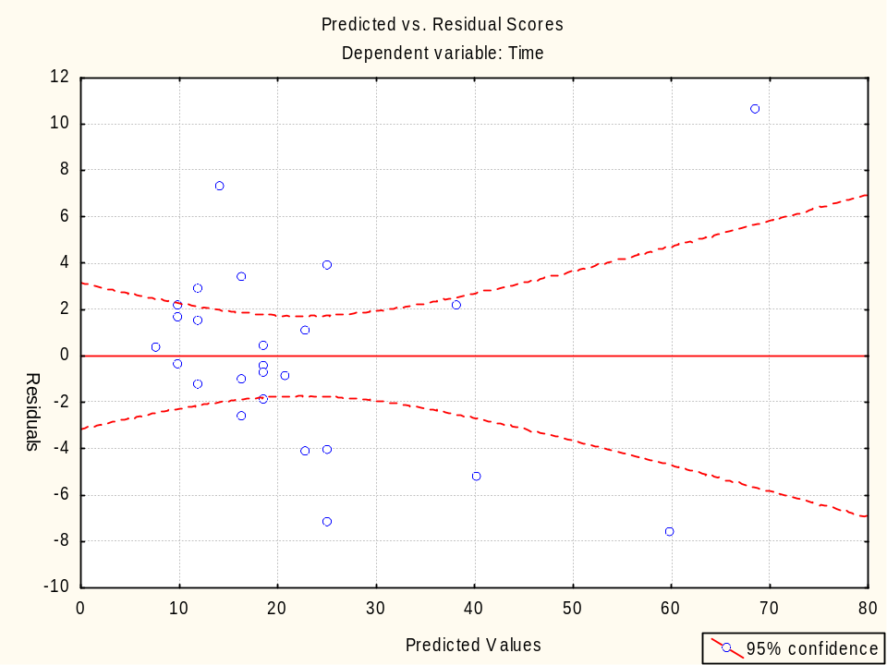
Notes:
Compare to FIGURE 23.4 Residual model diagnostics for regression analysis.
Page 495: “The values beyond 10 could almost be considered an extrapolation to the majority of data used fitting this model. In addition, the plots indicate that these values are not fitting the general model very well. The residual versus fitted plot indicates that there could also be an increase in the variability of delivery time with an increase in the number of cases.”
Page 496: “At this point in time the practitioner needs to stop and reflect back on the real purpose of the analysis.”

Slide 23
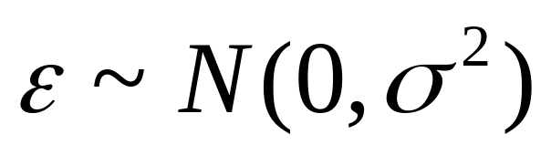
Multiple Regression
Notes:
Dependent variable Y
Explanatory variables X₁, X₂, …, X_{k}
Data:
(y₁, x₁₁, x₂₁, …, x_{k1})
(y₂, x₁₂, x₂₂, …, x_{k2})
…
(y_{n}, x_{1n}, x_{2n}, …, x_{kn})
Model:
Y = β₀ + β₁X₁ + β₂X₂ … + β_{k}X_{k} + ε
ε has normal distribution with μ = 0 and some standard deviation σ
[acknowledgement to Dr. Don N. Kleinmuntz, University of Illinois College of Business]

Slide 24
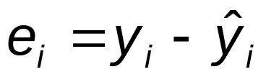
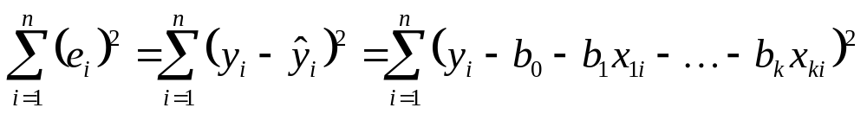
Model Estimation
Notes:
Goal: Choose b₀, b₁, . . . , b_{k} to minimize the residual sum of squares
[acknowledgement to Dr. Don N. Kleinmuntz, University of Illinois College of Business]

Slide 25
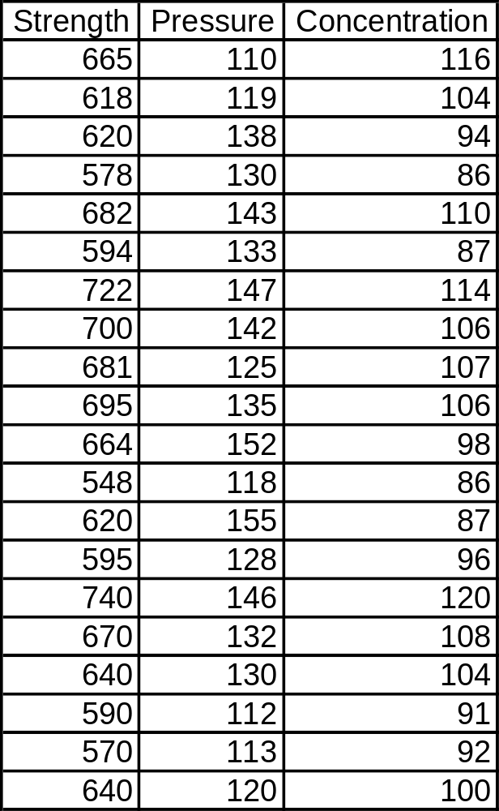
Table 26.1 Data for Multiple Regression Model of Product Strength
Notes:
26.3 Example 26.1: Multiple Regression
Page 534: “An investigator wants to determine the relationship of a key process output variable, product strength, to two key process input variables, hydraulic pressure during a forming process and acid concentration.”

Slide 26
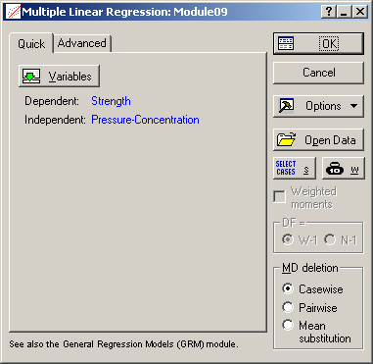
Notes:
Statistics > Multiple Regression
Dependent = Strength
Independent = Pressure and Concentration

Slide 27
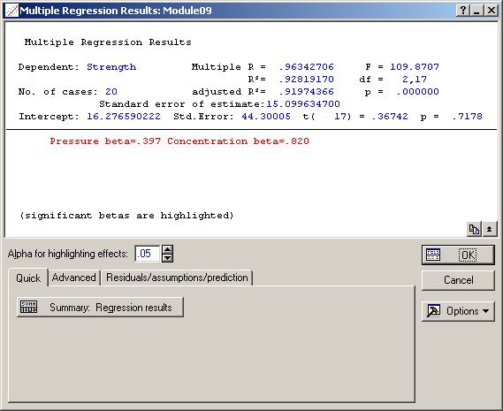
Notes:
Summary statistics are listed on top, e.g.:
Multiple R = 0.963
R² = 0.93
Intercept = 16.28 with a p-value = 0.72
Select “Summary: Regression results”

Slide 28
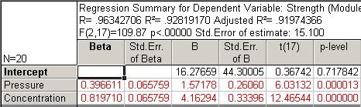
Notes:
Compare top section of the “Regression Analysis” listed on page 534.
The Intercept term equal to 16.28 (p-value = 0.72) is not statistically significant.
The slope for Pressure equal to 1.57 (p-value = 0.00) is statistically significant.
The slope for Concentration equal to 4.16 (p-value = 0.00) is statistically significant.
Remove the Intercept term and redo analysis.

Slide 29
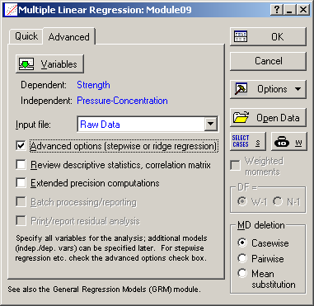
Notes:
Hit the “Cancel” button to return to the “Multiple Linear Regression” menu, select the “Advanced” tab, check the “Advanced options” box, and then click “OK”.

Slide 30
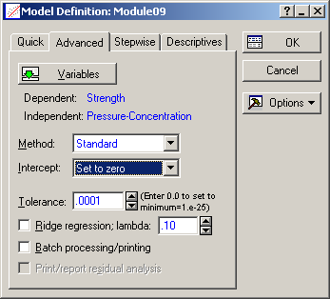
Notes:
In the “Intercept” drop-down box, select the “Set to zero” option and click “OK”.

Slide 31
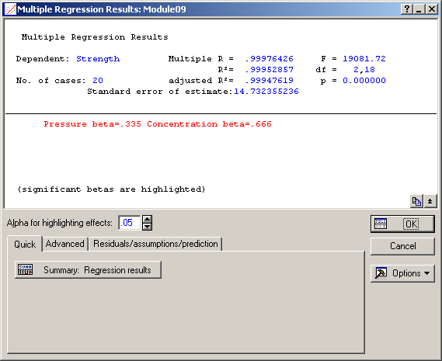
Notes:
Summary statistics are listed on top, e.g.:
Multiple R = 0.9997...
R² = 0.9995...
Warning: Because of the way many statistical packages calculate the R and R² values, when the intercept term is removed, the R and R² values greatly increase, often to values near 1, but the fit hasn’t improved at all (because the intercept term is merely a constant added to the regression equation, which you have just removed). If you calculate R and R² using the Sum of Squares approach, you will find that their values are the same as when the intercept term is included. So in this case, Statistica should report:
Multiple R = 0.963
R² = 0.93
Select “Summary: Regression results”

Slide 32
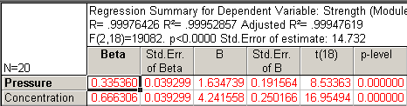
Notes:
The slope for Pressure changed from 1.57 to 1.63 (p-value = 0.00) and is statistically significant.
The slope for Concentration changed from 4.16 to 4.24 (p-value = 0.00) and is statistically significant.
So the equation to predict Strength is:
Strength = 1.63(Pressure) + 4.24(Concentration)

Slide 33
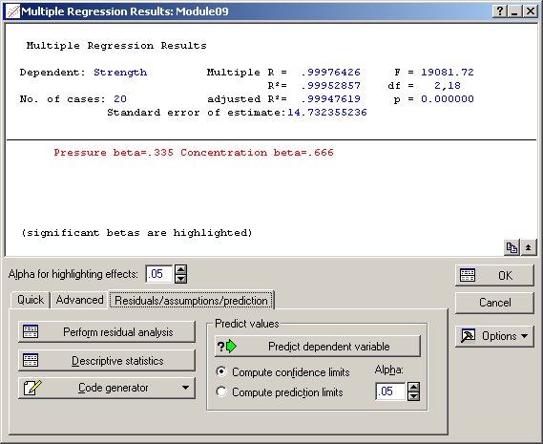
Notes:
Return to the “Multiple Regression Results” menu, go to the “Residuals/assumptions/prediction” tab, and select “Perform residual analysis”.
Then select:
“Normal plot of residuals” on the “Probability plots” tab
“Histogram of residuals” on the “Residuals” tab
“Predicted vs. residuals” on the “Scatterplots” tab
“Save residuals & predicted” on the “Save” tab
Then make an individuals (“X”) plot of the “Residuals” column using:
Statistics > Industrial Statistics & Six Sigma > Quality Control Charts

Slide 34
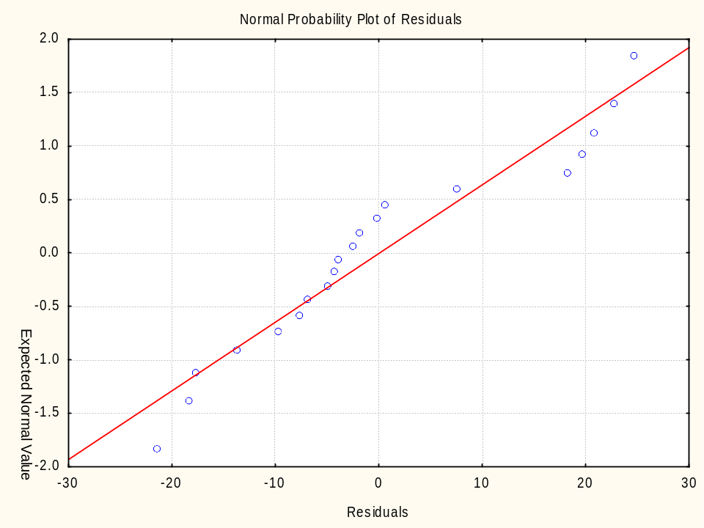
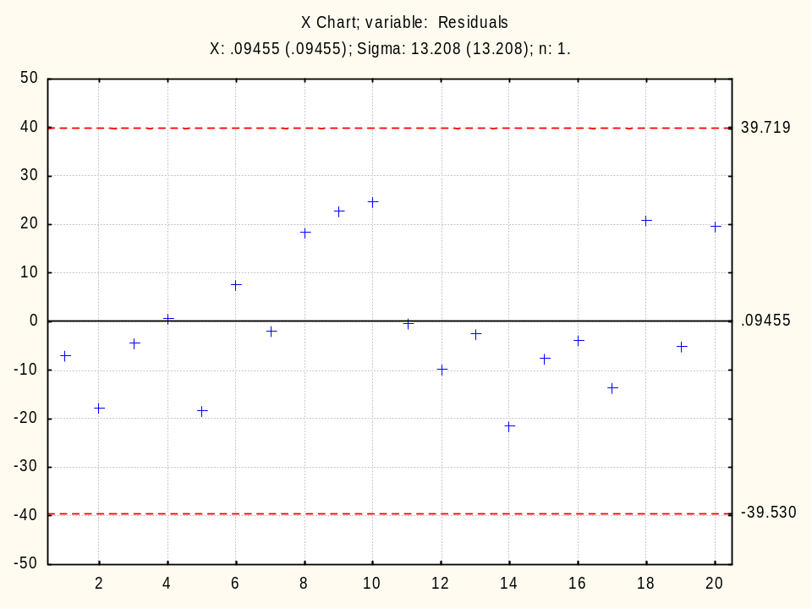
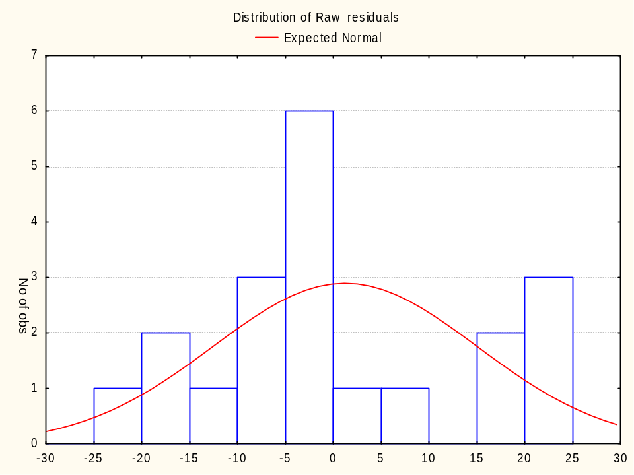
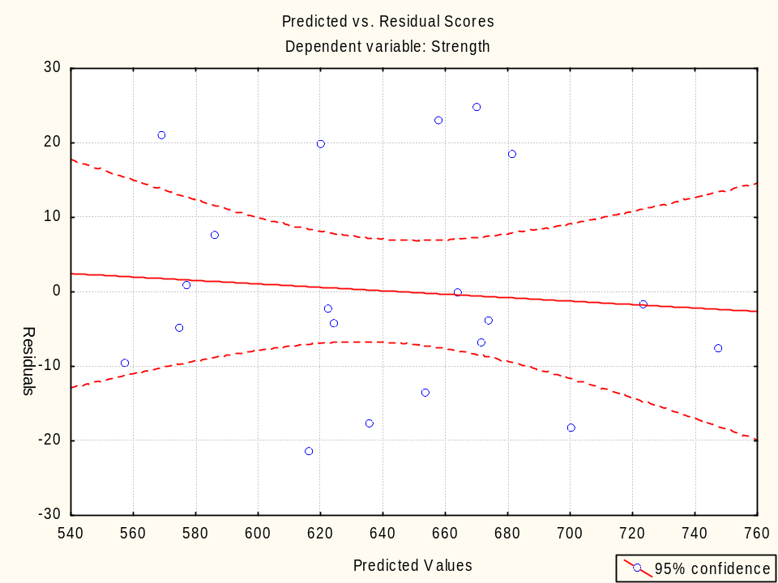
Notes:
There’s nothing seriously wrong with these diagnostic plots, so the model is probably adequate.
Remember: statistics means never having to say you’re certain.

